Slide 1

St Francis Xavier’s College
Course Preferences Information
Year 11 2025
Mr Colin Mulhearn – Assistant Principal – Teaching and Learning.
Notes:
Welcome
My
On behalf of Greg Ptolemy College Principal,
Kathryn Johnson Assistant Principal – Wellbeing and Engagement
And
Cassie Mowbray College Ministry Coordinator.
Welcome to what we hope will be a very informative evening that will help you work with your child as they head into their Senior Studies.
To Begin
Oliver Grimson College Aboriginal Education Teacher for the Acknowledgement
Cassie Prayer

Slide 2


Acknowledgement of Country.

Slide 3
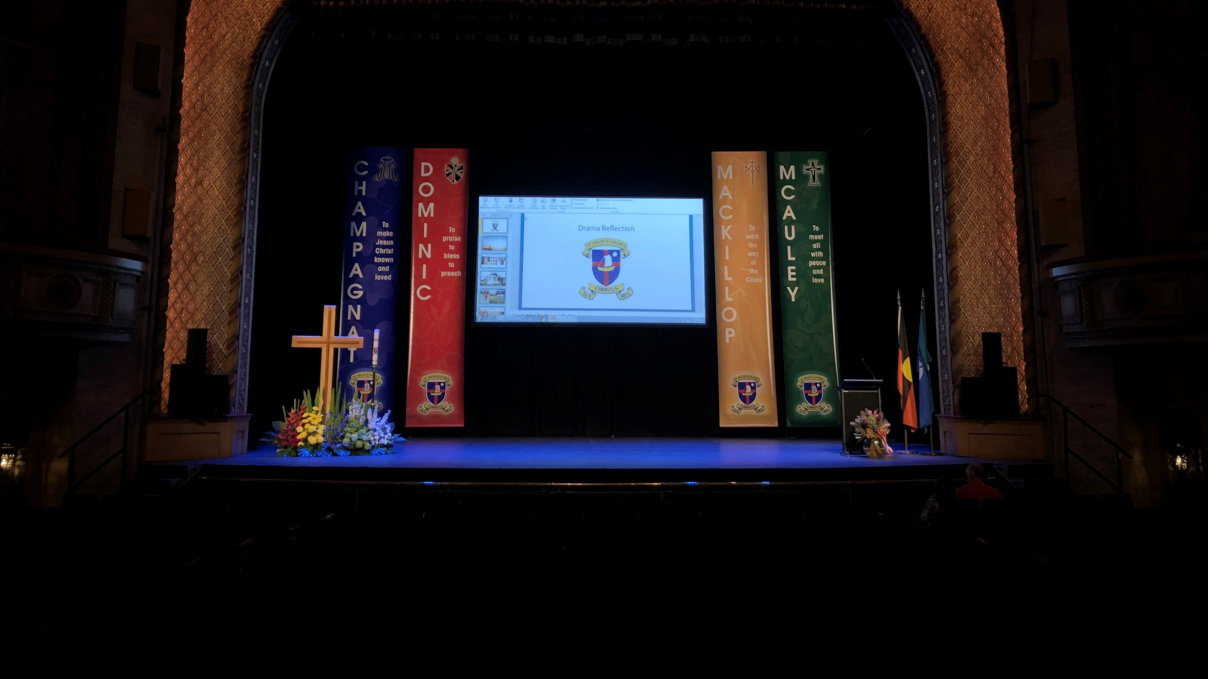
Prayer

Slide 4

College Principal – Greg Ptolemy

Slide 5
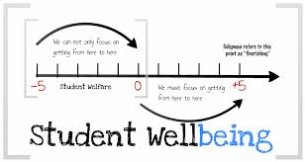
Kathryn Johnstone
Assistant Principal - Wellbeing and Engagement

Slide 6
Notes:
To begin the process a few words about what should/could help in deciding on the courses right for each student.
Supports multiple Pathways.

Slide 7
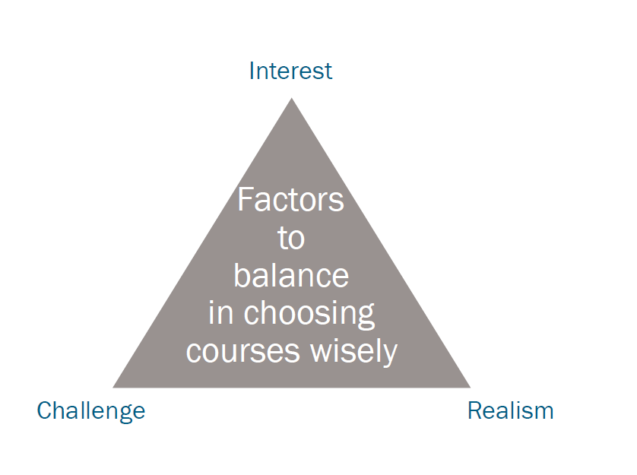
Factors that should form decisions.
Notes:
Challenge yourself.
Reach your potential.
Your Journey

Slide 8
Factors that should form decisions.
Interest.
Choose a course that interests you, something that has engaged you at your current school. Interest will keep your focus and attention and will more likely result in a positive achievement.
Challenge.
You need to choose courses that challenge you, that extend, and require you to work at. Studying courses because you believe they are easier may affect your overall achievement. Senior Studies is about extending you to allow you to reach your potential.
Realistic
What are you actually capable of. This is influenced by the level of study you have completed at Stage 5,… but not limited to this. Advice from your teachers, what you hear tonight, and the Curriculum Handbook will help in this. Choosing courses that are too difficult or too easy for you based on what others are doing or saying is a flawed strategy. It is your HSC, what do YOU want to study and what are YOU capable of.
N.B. It is always a fine line and a difficult task to get ‘Challenge’ and ‘Realistic’ right.

Slide 9
Terminology

Slide 10
‘Units’
2 units equates to 120 hours of study in a year.
Most subjects involve a 2 Unit Preliminary Course (120 Hours usually in Year 11) that is a prerequisite for the 2 Unit HSC Course (120 Hours usually in Year 12).

Slide 11
Patterns of Study
Preliminary Course requires a minimum of 12 Units.
HSC Course requires a minimum of 10 Units.

Slide 12
Subject Unit Value
HSC Subjects have a UNIT value;
    2 Units
        e.g. 2 Unit Economics, 2 Unit Food Technology, 2 Unit English
    1 Unit
        Some subjects are 1 Unit. e.g. Sports Lifestyle and Recreation Studies, Marine Studies, Photography or Exploring Early Childhood.
        Extension Courses in Maths and English are offered at the College and carry a value of 1 Unit. To do an extension course you need to be achieving highly in the subject.
        The extension course is done in conjunction with the 2 Unit Advanced course. So if you choose to study 1 Unit Extension Maths you must also study 2 Unit Maths Advanced.
        These are run before school from 8:00 am

Slide 13
Preliminary and HSC Course must have:
At least 6 Units from Board Developed Courses
At least 2 units of a Board Developed Course in English (English Studies fulfils this requirement)
At least 3 courses of 2 units value or greater
At least 4 subjects, including English
A maximum of 6 units may count from Science courses

Slide 14
Types of Courses
BOARD DEVELOPED COURSES
Academic Subjects that count toward an ATAR & HSC
VOCATIONAL EDUCATION and TRAINING COURSES (VET)
Can count toward an ATAR
but carry a focus on vocational skills. (Not Sports Coaching or VET Manufacturing and Engineering),
BOARD ENDORSED COURSES
Less Academic Subjects that DO NOT count toward an ATAR
TAFE COURSES – Separate Application Process. 23rd July
Less Academic Subjects that DO NOT count toward an ATAR, but focus on the development of specific skills. They fulfil HSC credential.
.

Slide 15
Board Developed Courses
These are the more academic style of course and count toward the ATAR. They are indicated as an ATAR Course in the Handbook and include subjects such as English, Mathematics, Biology, History etc
They will have Assessment Tasks throughout Year 11 and 12 and most of them include a HSC exam in November of Year 12.
Some subjects also have a Major Work or a Personal Interest Project which is due for submission to the Board of Studies usually in August of Yr 12 e.g. Drama, Music, Industrial Technology, Visual Arts etc. No more than 2 of these are recommended in a package as considerable time management skills are required to cope with such a workload.
Refer to the Curriculum HANDBOOK for details of subject requirements.

Slide 16
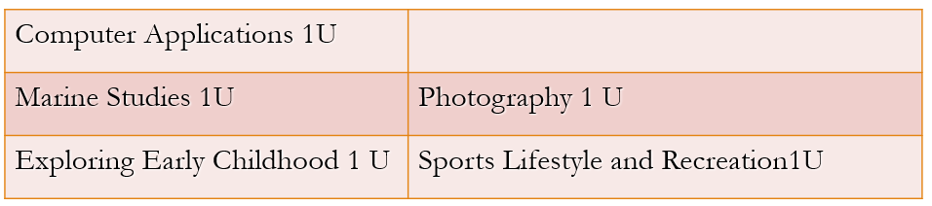
Board Endorsed Course
These subjects are less academic. These are indicated as ‘HSC Credential’ and ‘DOES NOT contribute to an ATAR’ in the Handbook.
They do count to the HSC but not to ATAR.
You may only study ONE of these 1U subjects.
You can study them in Year 11 and 12, or just Year 11.
They do not have a HSC exam but will have school assessments.
If Choosing STUDIES OF RELIGION 1U or CATHOLIC THOUGHT 1U then you MUST CHOOSE one of these courses to make your 12 Units.

Slide 17
Compulsory Courses
A minimum of 2 Units of ENGLISH; Advanced, Standard or English Studies is Compulsory
At least 1 Unit of Religion;
Catholic Thought 1 U or 2U
Studies of Religion 1U or
Studies of Religion 2U,
is required at St Francis Xavier’s
.

Slide 18
Future Directions
University
For students seeking to enter University immediately after school The Australian Tertiary Admission Rank (ATAR) is significant.
The HSC and the ATAR are completely separate. There are additional considerations for those seeking an ATAR.
Employment/Training
For students not seeking to enter University immediately after school you need to adhere to the GENERAL Rules of the HSC as already outlined.
Choose subjects that relate to a career area in which you are interested.

Slide 19
What is an ATAR
The Australian Tertiary Admission Rank
a number between 0.00 and 99.95
a rank, not a mark
used by universities to rank applicants for entrance into their courses.
.

Slide 20
ATAR Calculation
Best 10 units of Board Developed Courses.
2 units of English must be counted.
The best 8 units from the remaining Board Developed Courses.

Slide 21
Vocational Courses
Courses offered at SFX.
Construction, Hospitality, Entertainment, Retail, Business Services. Can count to an ATAR
Sports Coaching & Manufacturing and Engineering.
Non ATAR
TAFE – Ms Phillips.
Packages with a consideration of a Career. Separate Application process.
All students still need to select a full package to begin the year.
Notes:
Sports coaching and Manufacturing and Engineering can not be included in an ATAR – they are Not Board Endorsed.

Slide 22
Language Course through Distance Education
New South Wales School of Languages
Camden Haven High School
Separate Application process. Upfront Costs per course.
All students still need to select a full package to begin the year
Notes:
Still chose 12 units in your preferences.

Slide 23
Accelerated Mathematics & Religion
Accelerated Mathematics students will select Mathematics Advanced - Accelerated. Only students that are currently completing Year 11 Mathematics Advanced Course.
Students wishing to choose Accelerated Religion course need to apply separately (information in the handbook). Must be completing English extension 1 or Mathematics extension 1.
Select 2 Unit Studies of Religion on your form. Those successful
will be put into correct class for next year.
.
Notes:
In your Course preferences please select Mathematics Accelerated.
Only if you are currently completing Year 11 Mathematics Advanced
Accelerated Religion. Please select this option in Course preferences.
Positions offered to this class from the separate application process.

Slide 24
Life Skills Courses.
Life Skills and Learning Support - Mrs Te Moana
MacKillop Centre – Learning Support
Transition process between your current school and SFX

Slide 25
Choosing Courses Wisely.
ENJOYMENT & Interest. - Students traditionally do well in subjects that they like.
LEVEL - Choose a level of subject that suits your skills. Avoid subjects that are either too difficult or too easy for you. Speak to your teachers who are in the best position to advise you.
CAREER - Choose subjects that relate to your future direction as far as possible.

Slide 26
Choosing Courses Wisely.
Avoid choosing subjects based upon teacher you believe will be
teaching a course.
Avoid choosing subjects based upon the selections of OTHER
STUDENTS.
Avoid choosing subjects that you think will ‘SCALE’ well.
.

Slide 27
The Process
Term 1 – Distribution of Curriculum Handbook.
NB: ONE Change - Industrial Technology Graphics will not be offered.
Thursday 16th May – Course Preference Information Evening. Students to visit individual course presentations.
Friday 17th May – Course Preference, online access will be emailed to all Parents
Friday 24th May - Online Course Preference and Enrolment applications are due .
Parent/Student Transition interview
Monday 21st Oct – Friday 1st November (Weeks 2 & 3 Term 4.)
Orientation Days – 26th November (Pathway) 28th Nov (Other)

Slide 28
Important Dates for Enrolment Period. San Clemente
Enrolment Process
Currently open – online process
Completed Enrolment Form & Accompanying Documentation due back to the College
Closes Friday 24th May.
Online Course Preference entry.
Email sent tomorrow all students tomorrow for online slections.
Closes Friday 24th May.
Course Lines and offerings determination – College
Friday 7th June – Offers made to students and Course Offerings Confirmed.
Friday 21st June – Acceptance of Offers. $100 Non-Refundable enrolment
fee to secure position

Slide 29
Important Dates for Enrolment Period. St Pius (Trinity)
Enrolment Process
Currently open – online process
Completed Enrolment Form & Accompanying Documentation due back to the College
Closes Friday 24th May.
Online Course Preference entry.
Email sent tomorrow to those that have
submitted enrolment application.
Have indicated through the CSO survey they intend to come to SFX or indicated undecided.
As applications are received over the next week then you will be added to Course Selection Process.
Closes Friday 24th May.
Course Lines and offerings determination – College
Friday 7th June – Offers made to students and Course Offerings Confirmed.
Friday 21st June – Acceptance of Offers. $100 Non-Refundable enrolment
fee to secure position

Slide 30
Important Dates for Enrolment Period. Other Schools
Enrolment Process
Currently open – online process
Completed Enrolment Form & Accompanying Documentation due back to the College
Closes Friday 24th May.
Online Course Preference entry.
Email sent tomorrow to those that have submitted enrolment application.
Applications received up to 24th May will be added to online Course Preferences process as we receive your application.
Closes Friday 24th May.
Course Lines and offerings determination – College
Ongoing.
Parent / Student Interviews Non-Pathway Students - Occurring throughout the term in support of enrolment offerings being made.
Enrolment Offers to non-pathway students - Parents will be notified by mail/email regarding successful & unsuccessful placements.
Acceptance of Offer – $100 Non-Refundable enrolment fee to secure a
position

Slide 31
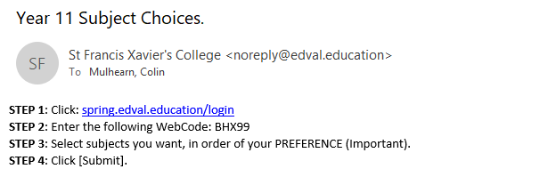
How to give your Course Preferences.
An Email and will be sent to those that have submitted an enrolment package on Friday 17th May.
Subject preferences Opens Online Friday 17th May.

Slide 32
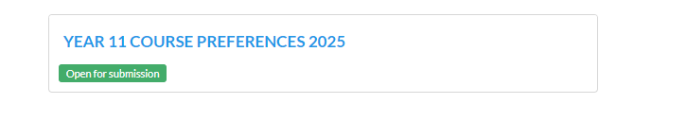
Course Preferences - Online

Slide 33
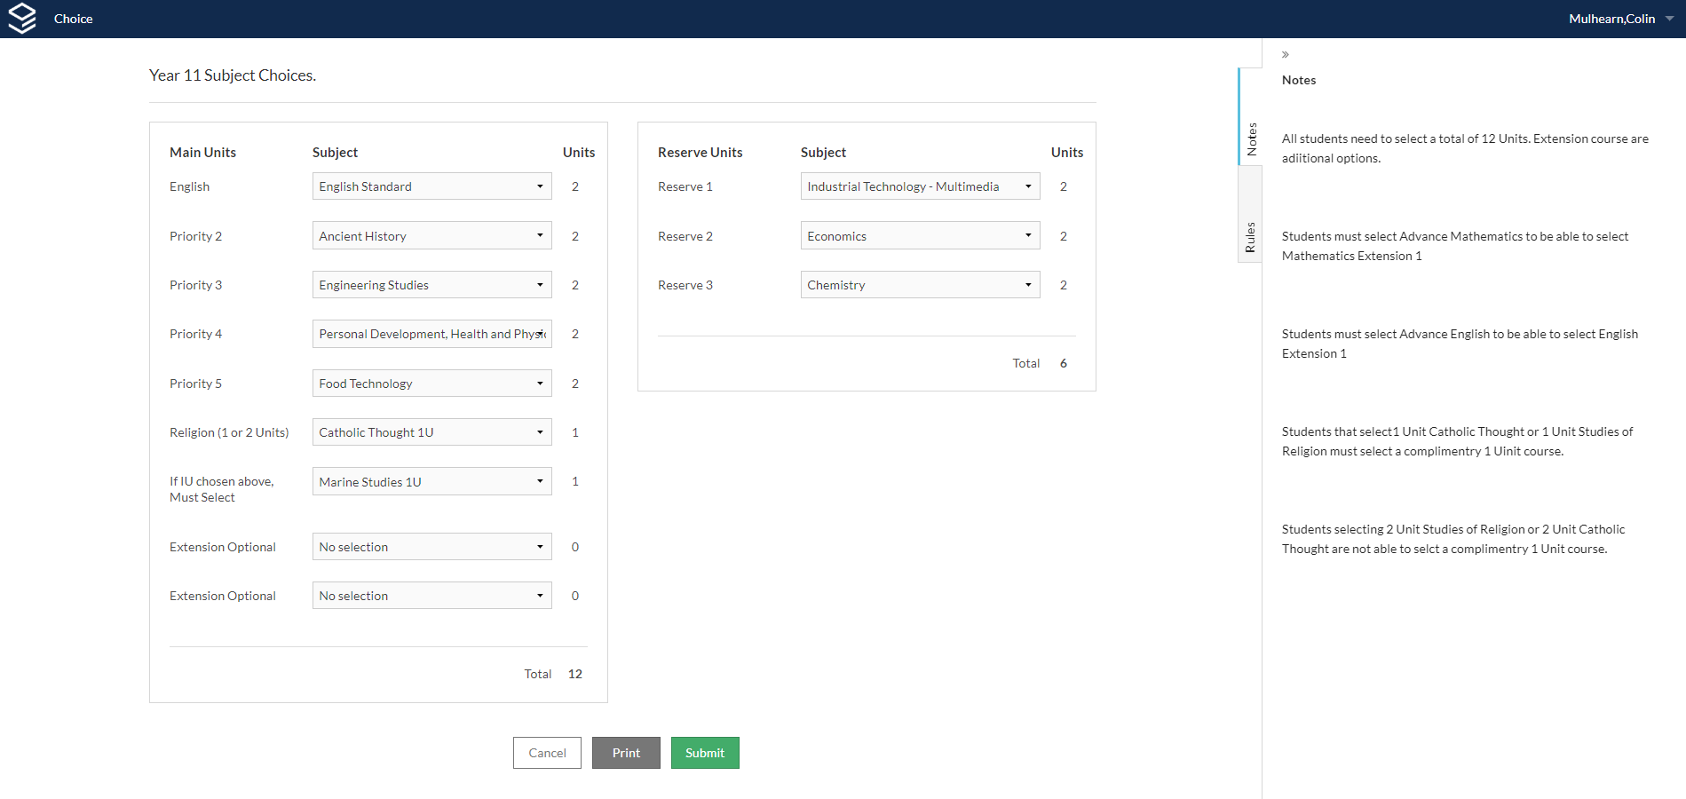
Course Preferences - Online

Slide 34
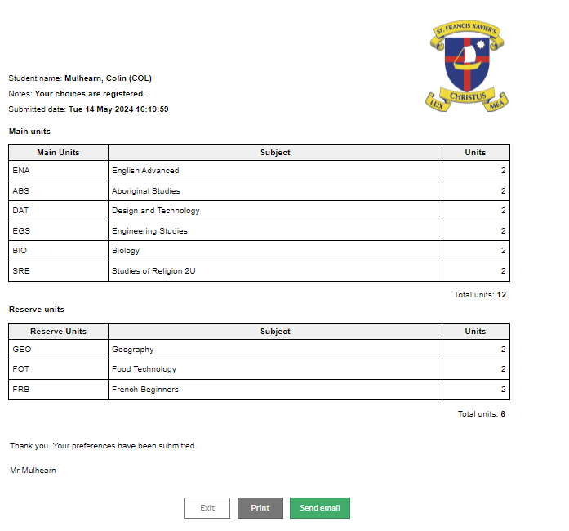
.

Slide 35
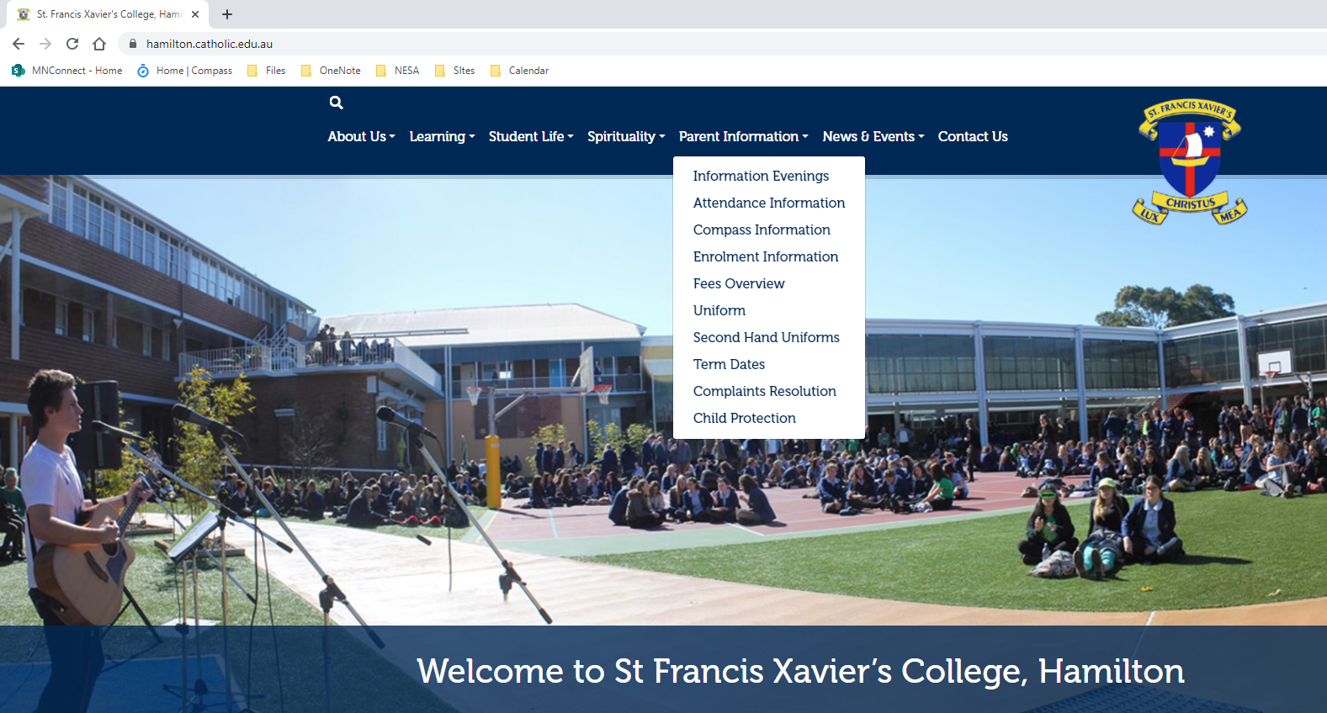
Where to find this Information/Presentation.

Slide 38
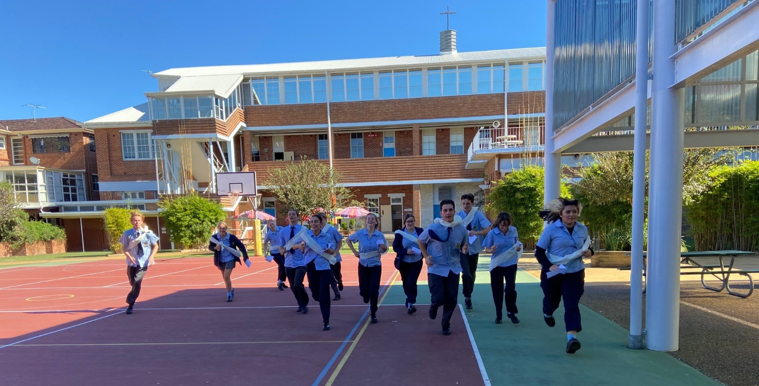
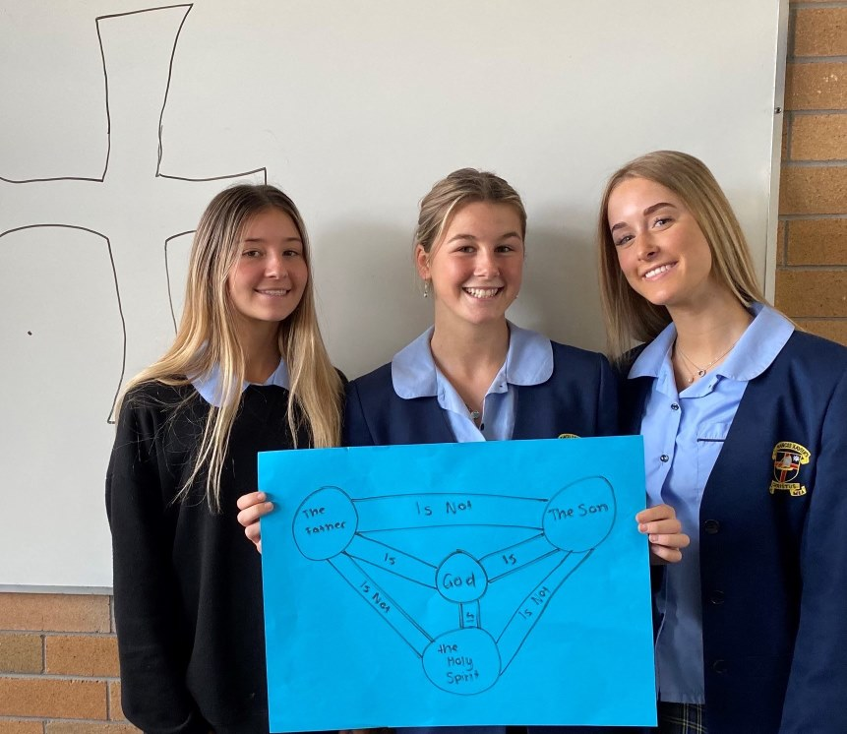
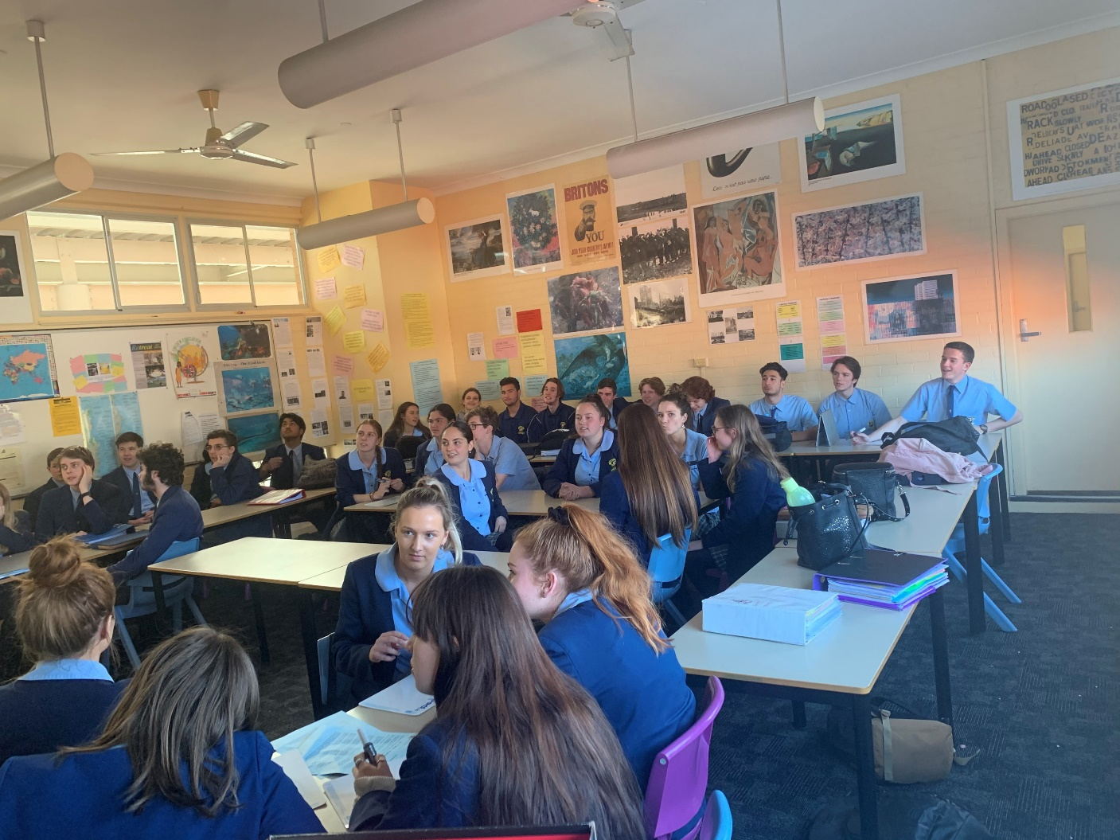
Introduction
Every student at SFX studies a religion course
1 Unit Studies of Religion
- 2 Unit Studies of Religion
- 1 Unit Accelerated Religion
- Studies of Catholic Thought
Notes:
The two core offerings are SoR and Studies in Catholic Thought.
Sor 1 and 2 unit both count toward the HSC and ATAR, while Studies in Catholic Thought counts toward the HSC but not the ATAR

Slide 39
Studies of Religion –
For those students who are interested in studying their own religious worldview and that of others
Both SoR courses contribute strongly toward the ATAR, but they do demand some serious written skills. We would strongly recommend these courses for English Advanced students as well as stronger English Standard students
Students who are independent thinkers and are interested in the world around them
Students who are motivated and willing to work
Students who are interested in career where you work with our diverse Australian community

Slide 40
What is the difference between 1 & 2 Unit Studies of Religion ?
1 Unit 2 Unit
- 2 periods a week - 4 periods a week
study 2 religious traditions - study 3 traditions & 2 extra topics (Peace
(Religion & Non Religion)
- 90 minute HSC exam - 3 Hour HSC Exam

Slide 41
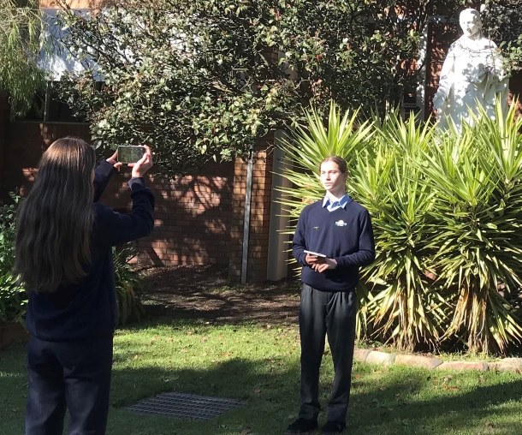
Studies in Catholic Thought
Is a content endorsed course that does not contribute to the ATAR but to the HSC
Focuses on the Catholic tradition
Studies in Catholic Thought counts toward the HSC but not the ATAR.
You can still do Catholic Thought and receive an ATAR as long as you are undertaking 10 other BDC units.
Draws on the liberal arts approach based on philosophy, the arts, history , scripture and Catholic beliefs
1 Unit 2 unit
2 periods a week 4 periods a week
Assessment is school based with 3 tasks per year.
No external HSC

Slide 42
ACCELERATED STUDIES OF RELIGION – 1 UNIT
Only students studying Extension English or Extension Maths are eligible.
Students study the Year 11 and Year 12 One Unit Course in one year – 4 periods a week. Students sit the HSC exam at the end of Year 11.
There is a selection process to be considered for this course – see handbook

Slide 45
English
Important Information:
English is compulsory for the HSC
Advanced, Standard and Extension English involve completing external HSC exam(s) at the end of the course, and you can choose to sit the external exam for Studies
If you elect to receive an ATAR to get into university, in addition to your HSC, then your English result will automatically be counted, regardless of your mark
There is no easy option in English
All courses require regular homework and independent research
Assessment includes exam style and supported tasks
Course Selection Choices:
English Advanced
with options of
Extension 1 /Extension 2
English Standard
English Studies
4 x 1 hour classes per week

Slide 46
Year 11 English
In Studies, Standard and Advanced Year 11 English 2025,
students will complete:
Standard & Advanced & Studies: Common Module: Reading to Write
Studies: On the Road Module
Standard Module A: Contemporary Possibilities
Advanced Module A: Narratives that Shape our World
Studies: Playing the Game Module
Standard Module B: Close Study of Literature
Advanced Module B: Critical Study of Literature

Slide 47
Text Types
Advanced:
Year 11 - Range of text types
Year 12 - FOUR prescribed texts, drawn from:
- Shakespearean Drama
- Prose Fiction
- Poetry or Drama
- Film, media or nonfiction
Standard:
Year 11 - Range of text types
Year 12 - THREE prescribed texts, drawn from:
- Prose Fiction
- Poetry or Drama
- Film or media or nonfiction
Studies:
Year 11 and 12 – A range of texts types including: shorter texts, contemporary texts, multimodal texts, film and a novel

Slide 48

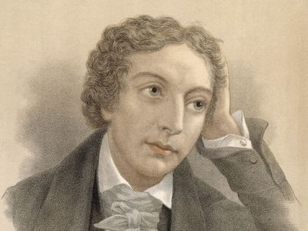




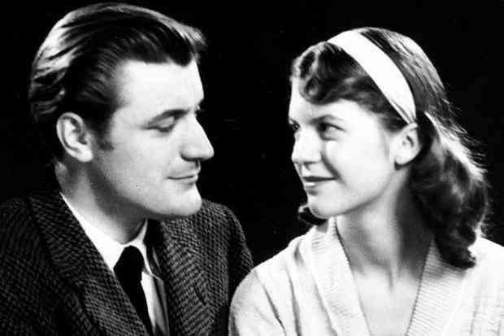
Text Types
Advanced English emphasises challenging, often pre-20th Century texts
Standard English emphasises Australian texts and contemporary texts

Slide 49
Course Expectations
English Advanced requires you to be already accomplished at English:
Independent reading skills – you will be expected to read the texts at home prior to starting to study them in class
An ability to think critically and conceptually – the content and criteria is complex and challenging
Keeping up – the pace is quite fast
Confident writers, with sophisticated sentence construction, grammar and vocabulary
Effective essay writers – essays are to be written in the final HSC exams
Organised, hard-working and enthusiastic – ready for the challenge!

Slide 50
Course Expectations
English Standard requires:
Independent reading skills – you will be expected to read the texts at home prior to starting to study them in class
An ability to think critically and discuss ideas
Working steadily each week
Capable writers, with competent sentence construction, grammar and vocabulary
Competent essay writers – essays are to be written in the final HSC exams
Organised, hard-working and enthusiastic – ready for the challenge

Slide 51
Course Expectations
Assessment: There are three assessment tasks for all 2 Unit Courses in Year 11 that take the form of
Supported Tasks and Exam Style
Should I do English Studies?
I would not put English in my top 3 subjects and would prefer to devote more time to others
I need assistance in developing my writing
I have vocational aspirations to work/do an apprenticeship or go to TAFE and don’t need an ATAR
I understand that I can get an ATAR if I sit the HSC Exam

Slide 52
Course Expectations
Assessment: There are three assessment tasks for all 2 Unit Courses in Year 11 that take the form of
Supported Tasks
Exam
Should I do English Standard?
I have performed satisfactorily in Year 10 English
I am not that keen on Shakespeare, I prefer more modern texts
I need assistance in developing my extended writing
I need 2 units of English for university study
I am prepared for homework and independent study

Slide 53
Course Expectations
Should I do English Advanced ?
I love English
My Year 10 English teacher believes that I can cope with the demands of this course – I can think critically and conceptually
Shakespeare is compulsory! Yippee!
I am a skilled writer who is willing to devote time to develop this skill further
I like to think critically and express my individual ideas
I am a keen reader, read widely across genres and enjoy the classics
I am motivated and organised and understand I am going to have to complete homework and independent research
I am considering studying English type subjects at university
I would like to do Extension 1 and/or Extension 2

Slide 54
Course Expectations- Year 11 Extension
In Extension 1, you complete a Module called:
Texts, Culture and Value
This involves critical analysis, independent investigation and the creation of extended creative compositions, as well as an independent research project.
Should I do English Extension?
I have selected Advanced English
English is one of my favourite subjects
I am a skilled writer who is keen to continue to develop in this area
I can think critically and conceptually
I am self-motivated and have well developed organisational skills
I am prepared to work independently and am a keen reader of a variety of texts
I would like to select Extension 2 English in Year 12

Slide 55
What does the data tell us?
It is important to choose the English course that sounds right for you.
There are many misconceptions about your English choice, such as:
- There is prestige in choosing Advanced English.
- Advanced is where the ‘good’ students go.
- Advanced will get you a better ATAR.
- The UAC guide includes English Advanced as a pre-requisite for some courses.
This simply isn’t true.
Universities do not know what you studied – they only know your ATAR – you get the best ATAR by being the best in your course, no matter what course it is.
Please feel free to ask the available English staff any questions you may have.
Call or Email the English Leader of Learning: mary.picton@mn.catholic.edu.au

Slide 57
McKillop Centre and Learning Support. Staff are available for information on Life Skills Courses or any general Learning Support questions. You will find their space just off the main yard.
Careers – Ashley Phillips – Open each session for questions
Please refer to Map and session venues that was sent to each family. Spare copies at back of hall.
Mr Ptolemy, Ms Johnstone and I will be in the main yard if you have any questions or are lost..
A bell will sound shortly to begin the first session. Bells will sound at the end of each session.
Each session will be 20 min. There will be 5 Sessions. Capacity.
.
.

Slide 58
Basic Layout….
A, B & C Block
BG.., CG.. etc = Ground Level
A10.. B10… etc = 1st floor.

